Slide 1
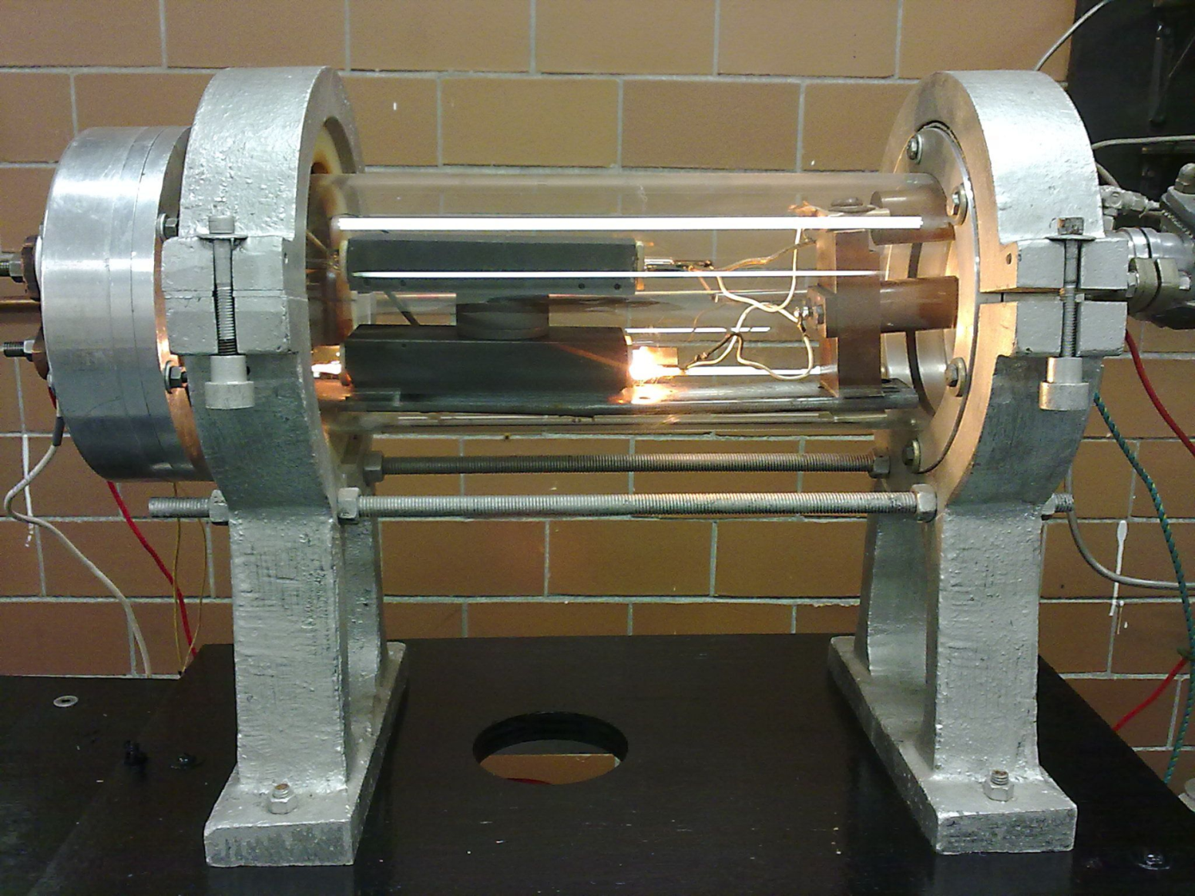
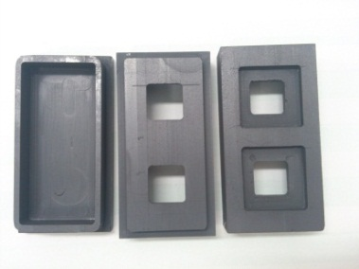
OPTICAL AND ELECTRICAL PROPERTIES OF ZnTe AND ZnTe:O THIN FILMS DEPOSITED BY CSVT TECHNIQUE
M. A. González Trujillo¹, M.L. Albor Aguilera², D.A. Rodríguez Morán³ ,Y. Matsumoto Kuwabara⁴ , M. Galván Arellano⁴, A. Morales Acevedo⁴, G. Casados Cruz⁴
¹ESCOM – IPN, Formación Básica, U.P.A.L.M., Zacatenco, México D.F., 07738, México.
²ESFM-IPN, Depto. Física, U.P.A.L.M., Zacatenco, México D.F. 07738, México.
³ESIQIE-IPN, Depto. Ing. Química Industrial, U.P.A.L.M., Zacatenco, México D.F., 07738, México.
⁴CINVESTAV-SEES-IPN, Av. IPN 2508, Zacatenco, México D.F. 07360, México.
ABSTRAC
Zinc Telluride (ZnTe) thin films were deposited onto glass and CdTe substrates by CSVT (Close Space Vapor Transport) technique. The analysis of the chemical compositions for the as-deposited as well as annealed ZnTe thin films was estimated by using the method of energy dispersive analysis of x-ray (EDAX). The morphological structural, optical and electrical properties were studied.
EXPERIMENT
Development
experimental
ZnTe Deposite
Tf=550°C
Ts=--- °C
Deposition time= 3 min
Sample a deposited on SnO2:F
Sample c deposited on glass
Sample b deposited on SnO2:F
Sample d deposited on glass
Sample e deposited on CdS
Sample f deposited on glass
Pessure: 100 mTorr (100% O2)
Pessure: 100 mTorr (100% Ar)
Pessure: 100 mTorr (100% O2)
CdTe Deposit
Tf=630°C
Ts=530°C
Deposition time= 3 min
Pressure: 100 mTorr; (50º% O2 and 50% Ar)
a
b
c
Figure 2. Evaporation Chamber for the ZnTe
Figure 1.Evaporation Chamber consists of a: a) block of substrate, b)block of source and c) graphite furnace
The deposition temperatures used for the samples were 530 °C and 630°C for the source (T1) and substrate (T2) respectively (fig. 1), under the following conditions: 0.1 Torr, controlled atmosphere (50% O2 and 50% Ar). 0,013 g was placed in a boat CdTe with three divisions , this was for three minutes. The CdTe samples were doped whit ZnTe using a source temperature of 550 °C on controlated atmosphere of O2 and Ar.
RESULTS
a)
b)
Figure 4. X-R spectra of (a),(c),(e) CdTe as grown; (b),(d) CdTe with ZnTe on diferent substrats
c)
d)
e)
f)
Figure 3. SEM images, 10 KV. Samples CdTe: a), c) and e) deposited at T1=630°C and T2=530°C. Samples CdTe/ZnTe were deposited at T1=630°C and T2=530°C, doped at T3=550°C: b) and d) on O2 atmosphere and f) on Ar atmosphere
Figure 7. Photoacoustic spectra of CdTe and ZnTe/CdTe
CONCLUSIONS
Table 1. Comparative chemical quantification, electric properties of CdTe and ZnTe/CdTe thin films.
● Electrical measurements reveals a CdTe conductivity is improved with Te.
● A p+ región was created with ZnTe.
● Crystalline quality is reduced by CdTe films with ZnTe. (annalysis of X-R and photoacustic spectra).
● The properties obtained with ZnTe how back contact can be use on photovoltaic dispositive.
Sample | EDAX |  |  | Thickness (µm) | Sheet resistance (Ω/ □ ) | Resistivity (Ω•m)
 | % Te | % Cd | % Zn
a) | 48.71 | 51.29 | --- | 7.3 | -- | --
b) | 57.29 | 42.51 | 0.41 | 8.5 | 47.40 x 10³ | 1.2 x10³
c) | 49.52 | 50.48 | --- | 5.6 | --- | --
d) | 57.09 | 42.76 | 0.15 | 6.9 | 81.25 x 10³ | 1.3 x10³
e) | 46.13 | 53.87 | -- | 18 | -- | --
f) | 56.76 | 43.24 | -- | 4.6 | 20.983 x 10³ | 8.7 x10²
REFERENCES
[1] M.L. Albor Aguilera y M. A. González Trujillo, Tesis de Licenciatura “Construcción de un Sistema de Crecimiento de Películas Delgadas Semiconductoras por la Técnica GREG", 1993.
[2] M. Tufiño Velázquez, G. Contreras Puente, M.L. Albor Aguilera, M.A. González Trujillo, A.D. Compaan, Revista Mexicana de Física 44(6) (1998) 589-595.
[3] A. Romeo, R. Wendt, et al, “Development of efficient and stable back contacs on CdTe/CdS solar cells” Thin solid films (2001).
[4] M. S. Hossain, R. Islam Et al, “Structural, elemental compositions and optical properties of ZnTe:V thin films”. Chalcogenide Letters Vol. 7, 2010.
[5]Dieter K. “Semiconductor material and device characterization” second edition, a Wiley-Interscience Publication, Canada, 1998

